Slide 1
Image Processing HW #1
2023. 04. 05.
성 용 욱
Embedded Control System Lab. Department of Electronics Engineering Pusan National University

Slide 2
1. 개발환경
Python
OpenCV
Matplotlib
Numpy
Scikit-Image

Slide 3
2. 기능 리스트
Interpolation (Zeroth-Order, Bilinear, Bicubic)
Geometric Transformation (Affine Transformation)
Histograms (Histogram Equalization)
Noise (Gaussian, Salt-and-Pepper)
Box Filter
Edge Detection (Sobel, Laplacian)
Unsharp Masking and Highboost Filtering
Mean Filters (Arithmetic, Contraharmonic)
Order-statistic Filters (Median, Max, Min, Midpoint)

Slide 4
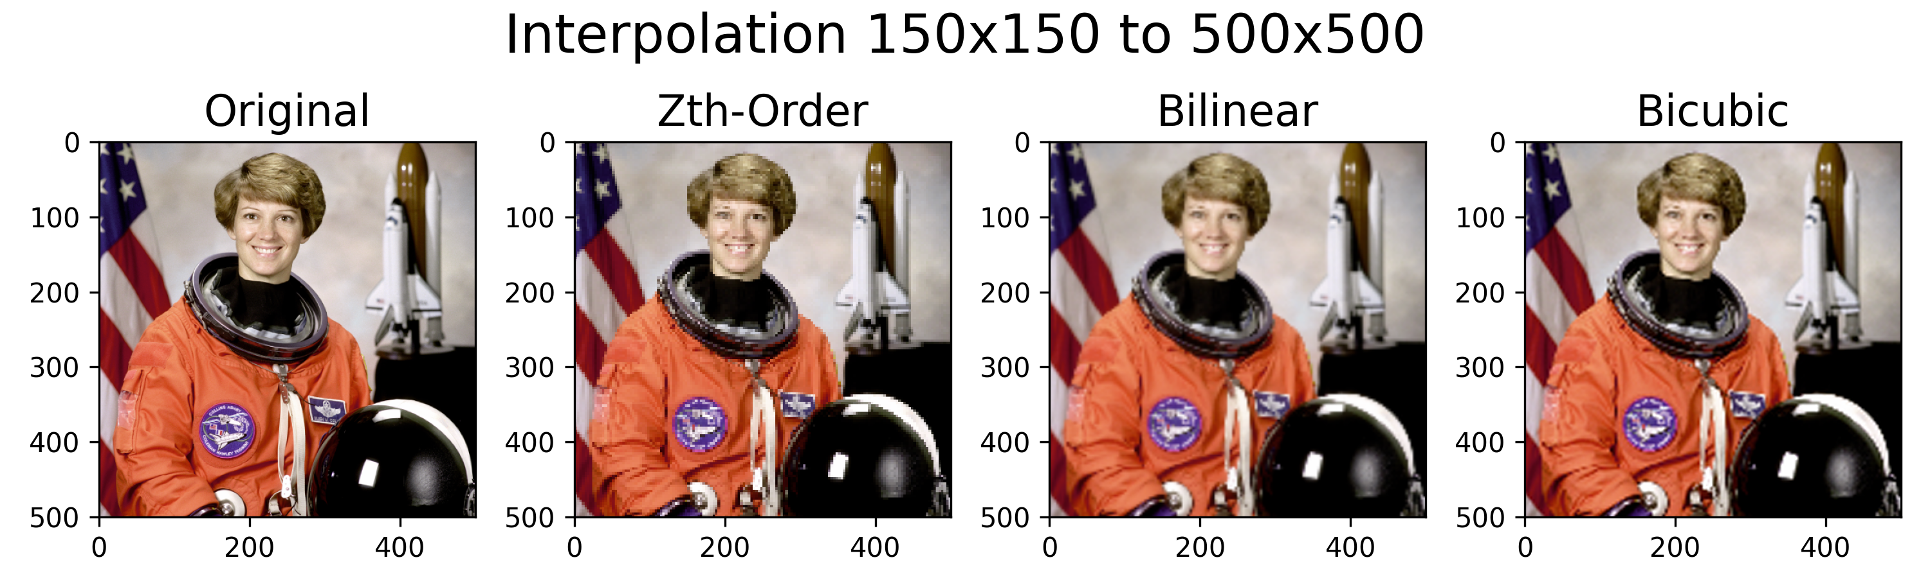
Interpolation
Zeroth-Order, Bilinear, Bicubic Interpolation
500x500 size의 원본 이미지를 Bilinear 방식으로 150x150으로 변환한 이미지를 각 Interpolation 방식을 적용해 500x500으로 변환
OpenCV resize 함수 interpolation=‘foo’옵션으로 지정 가능 (Default=Bilinear)
tt_image = cv2.resize(t_image, dsize=(150, 150)) zth_image = cv2.resize(tt_image, dsize=(500, 500), interpolation=cv2.INTER_NEAREST) bilinear_image = cv2.resize(tt_image, dsize=(500, 500), interpolation=cv2.INTER_LINEAR) bicubic_image = cv2.resize(tt_image, dsize=(500, 500), interpolation=cv2.INTER_CUBIC)

Slide 5
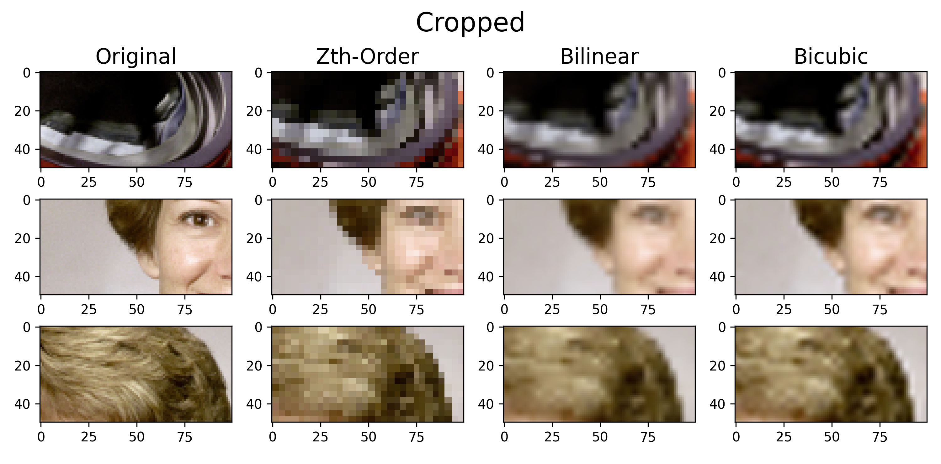
Interpolation
Zeroth-Order, Bilinear, Bicubic Interpolation

Slide 6
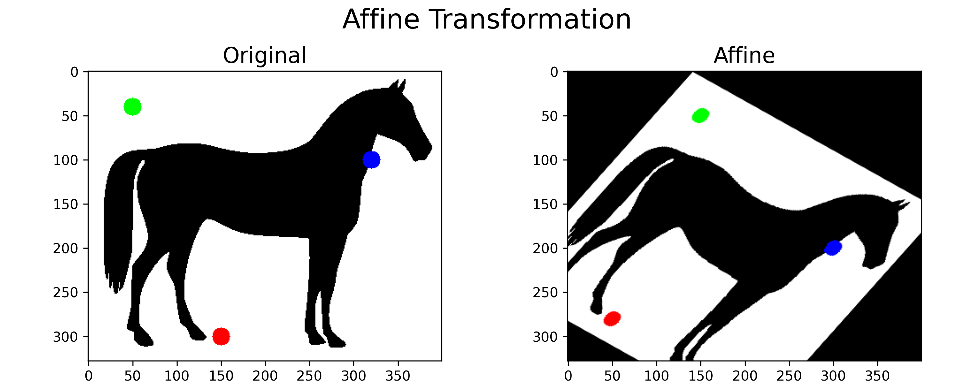
Geometric Transformation
Affine Transformation
변환 전/후 Point 3개를 통하여 Affine 행렬을 구하고
Affine 행렬을 적용하여 이미지를 변환
pt1 = np.float32([[320,100], [50, 40], [150, 300]]) pt2 = np.float32([[300,200], [150, 50], [50, 280]])
M = cv2.getAffineTransform(pt1, pt2)
tt_image = cv2.warpAffine(t_image, M, (cols, rows))

Slide 7
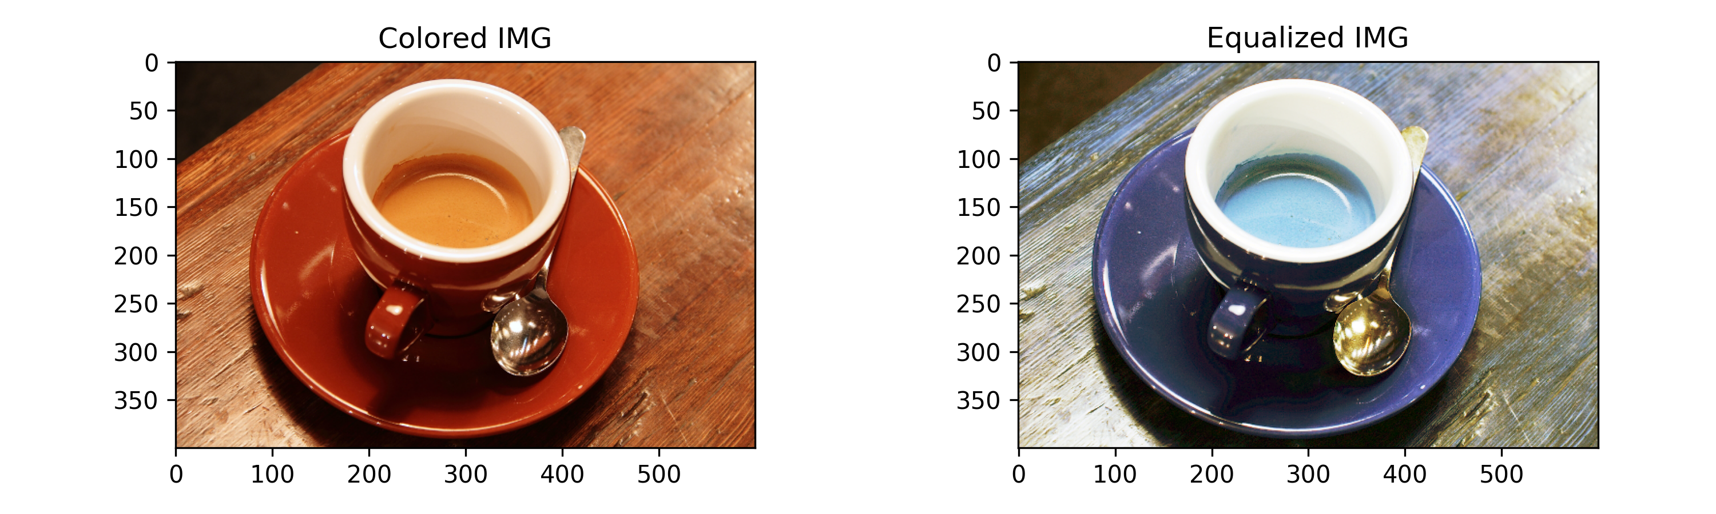
Histogram
Histogram Equalization
calcHist 함수를 이용하여 Histogram을 계산
equalizeHist 함수를 이용하여 Histogram Equalization 수행
Grayscale 이미지를 불러와 Equalization 수행 전/후의 Histogram을 비교
Color 이미지의 경우 YCrCb 색영역을 사용하여야 함
hist_bin = cv2.calcHist([t_image_bin], [0], None, [256], [0,256])
eq_bin = cv2.equalizeHist(t_image_bin)

Slide 8
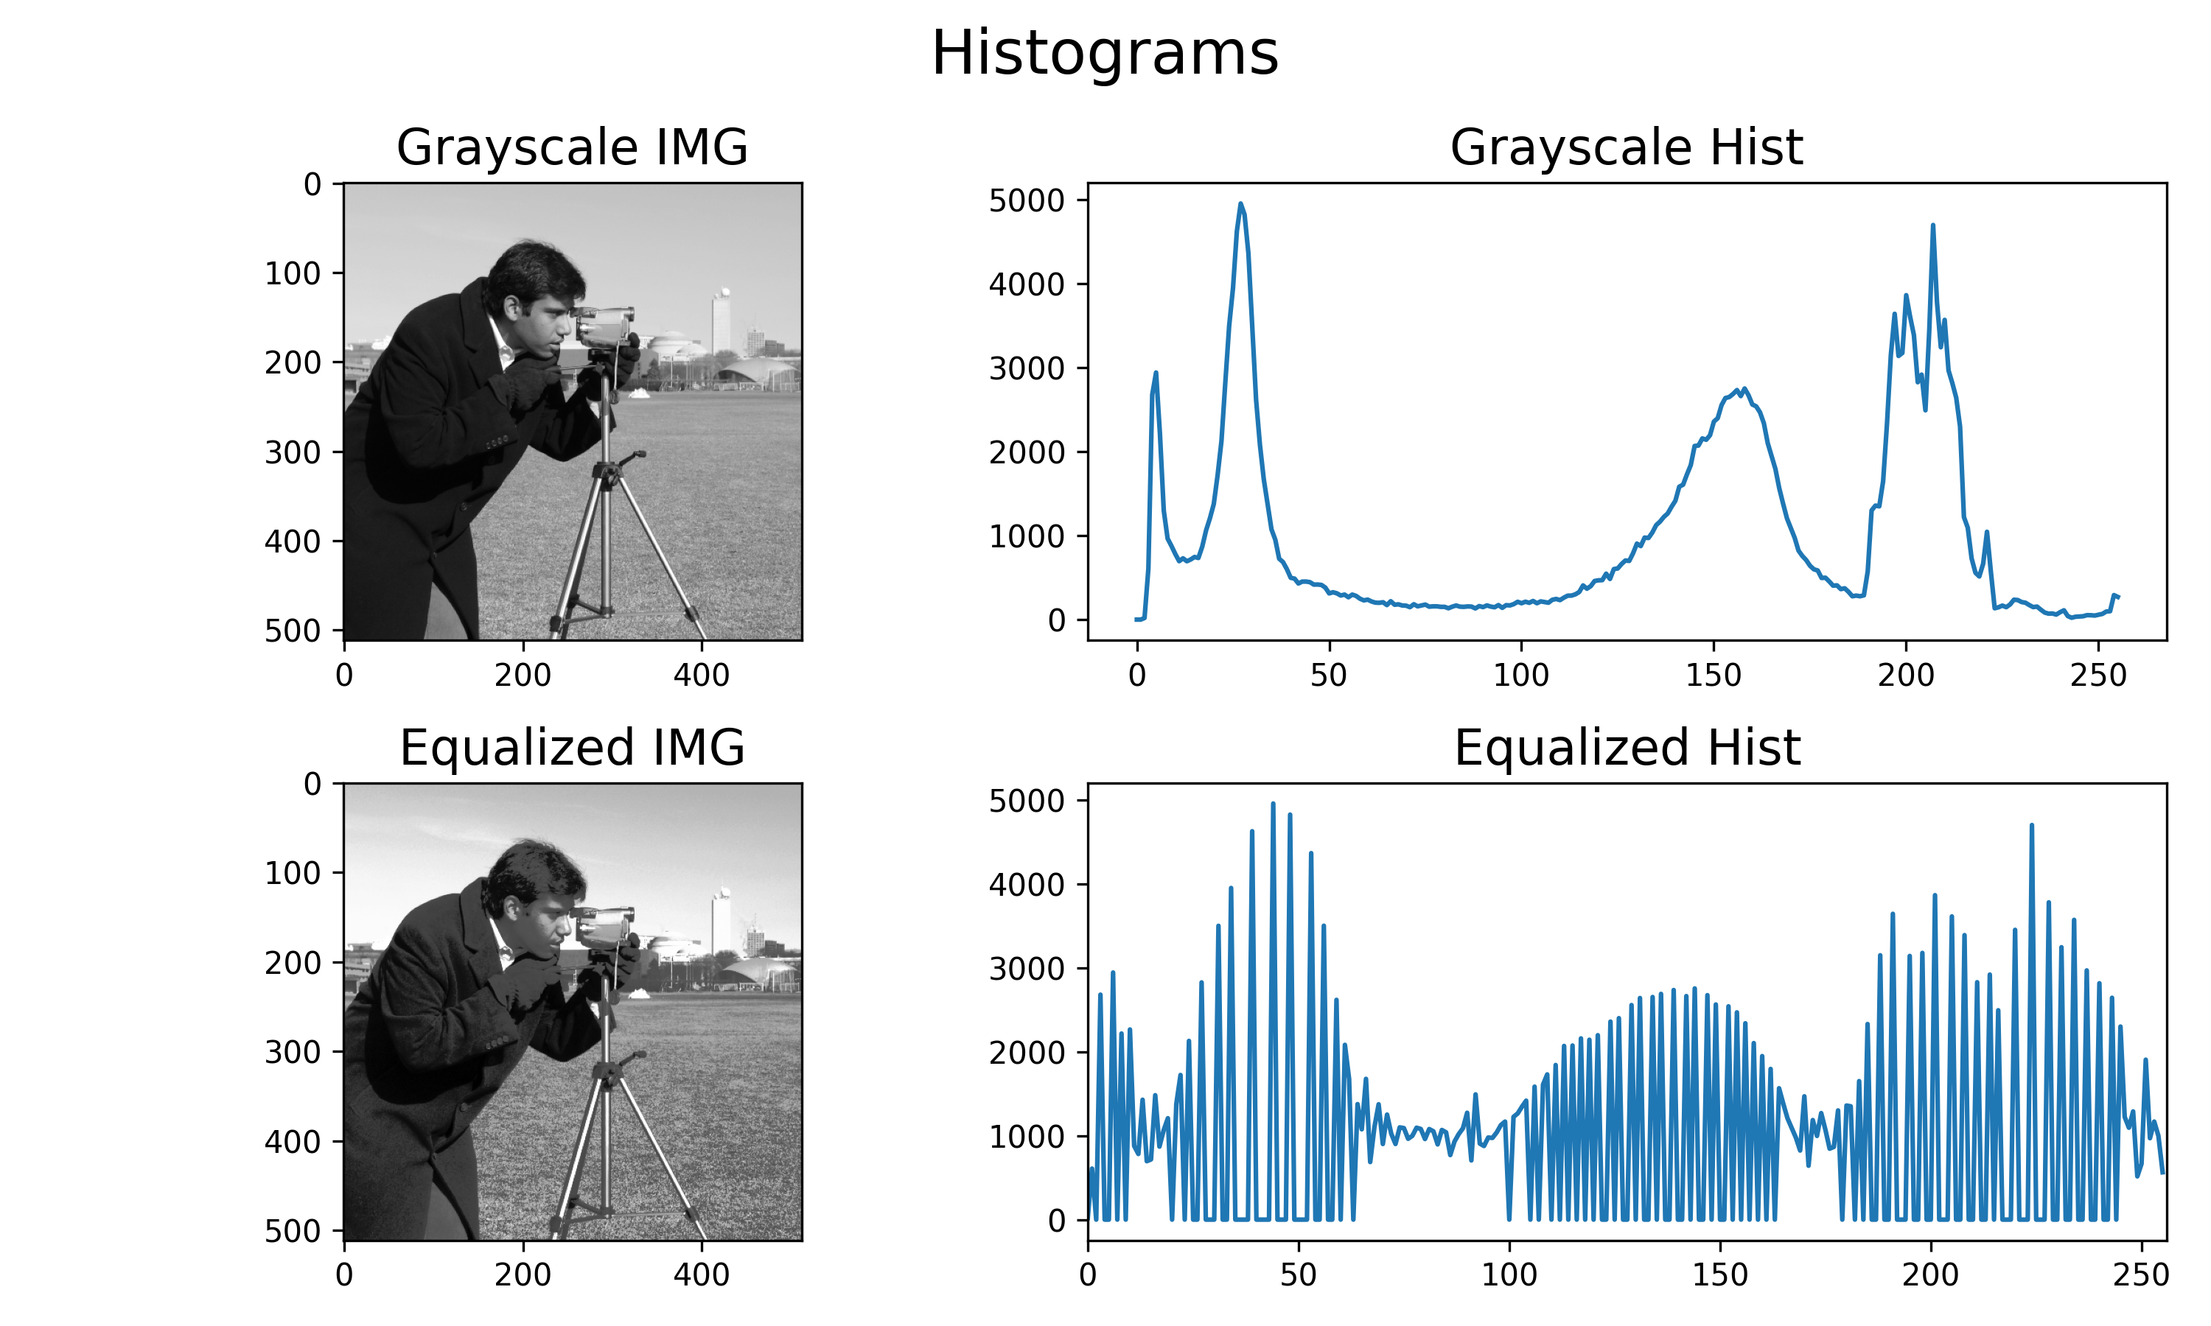
Histogram

Slide 9
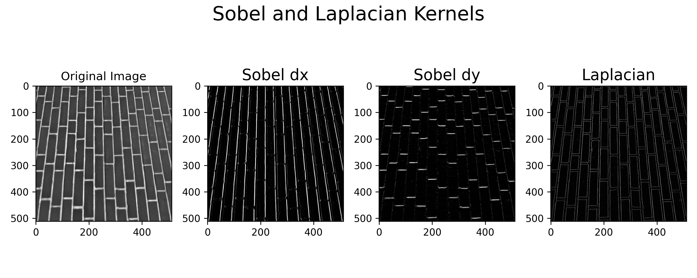
Edge Detection
Sobel
Laplacian
# cv2.Sobel(srcimage, ddepth, dx, dy, ksize, scale, delta, bordertpye) sobel_dx = cv2.Sobel(src_img, cv2.CV_8U, 1, 0, 3) sobel_dy = cv2.Sobel(src_img, cv2.CV_8U, 0, 1, 3)
# cv2.Laplacian(srcimage, ddepth, ksize, scale, delta, bordertpye) laplacian = cv2.Laplacian(src_img, cv2.CV_8U, ksize=3)

Slide 10
Unsharp Masking & Highboost Filter
Unsharp Masking
Unsharp Mask = 원본 이미지 – Blur 이미지
Highboost Filter
Sharpened Image = 원본 이미지 + k * Unsharp Mask
src_img = data.gravel() blr_img = cv2.blur(src_img, (3, 3)) msk_img = src_img - blr_img
def highboostfilter(src, msk, k): out_img = src + k * msk return out_img spd_img = highboostfilter(src_img, msk_img, 3)

Slide 11
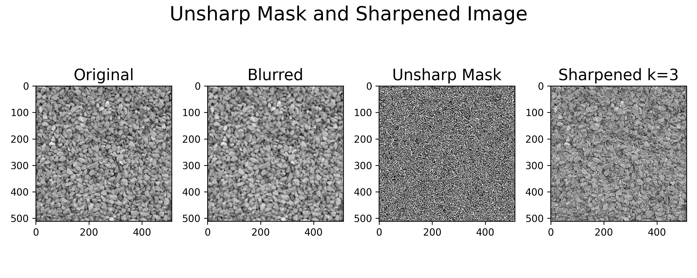
Unsharp Masking & Highboost Filter
Unsharp Masking and Highboost Filter

Slide 12
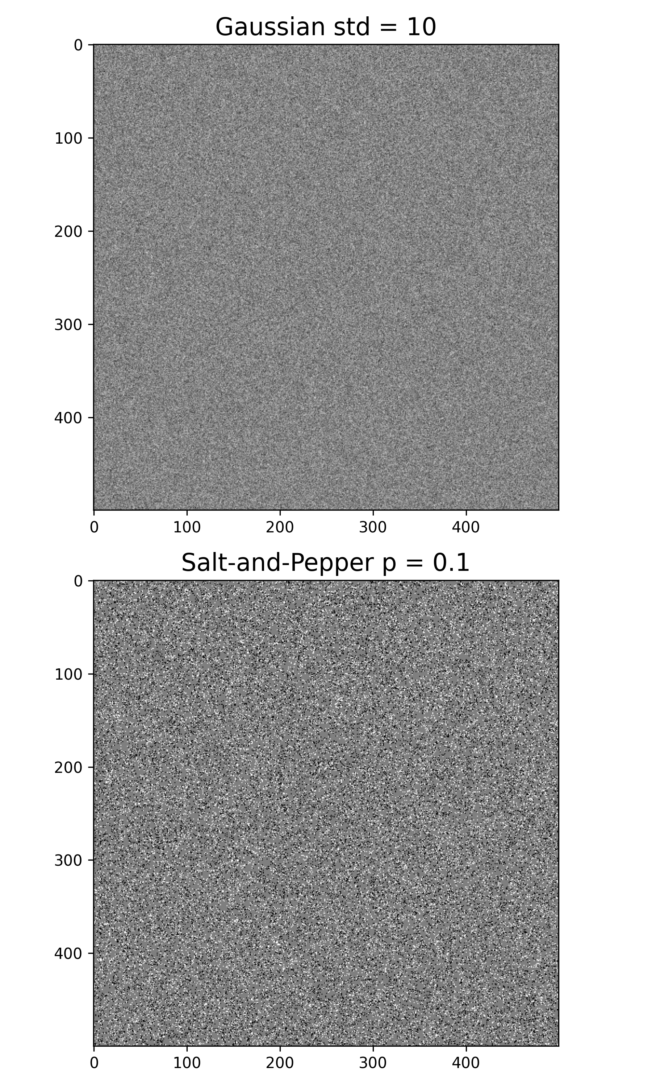
Noise
Gaussian Noise
Salt-and-Pepper Noise
def noise_gaussian(std, gray_img): gray_img = gray_img.astype(float) h, w = gray_img.shape gaussian = np.random.normal(0, std, (h,w)) noise = gray_img + gaussian noise = np.uint8(np.clip(noise, 0, 255)) return noise
def noise_sap(p, img): h, w = img.shape th = 1 - p noise = np.zeros((h, w), dtype=np.float64) for i in range(h): for j in range(w): rdn = random() if rdn < p: noise[i][j] = 0 elif rdn > th: noise[i][j] = 255 else: noise[i][j] = img[i][j] noise = np.uint8(np.clip(noise, 0, 255)) return noise

Slide 13
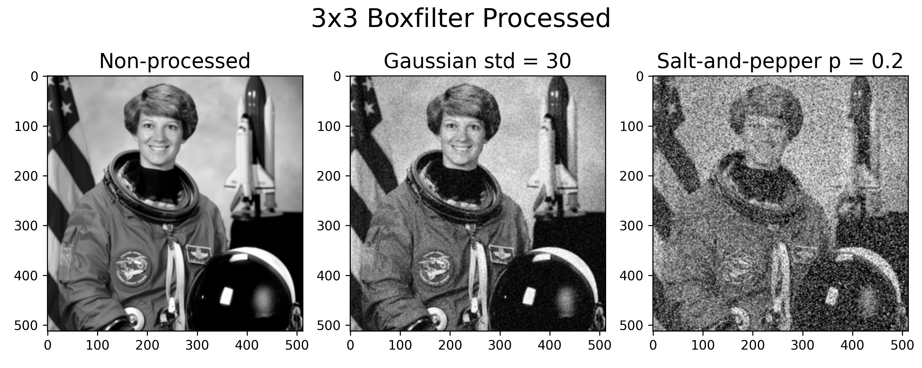
Box Filter
OpenCV blur 함수 = Identical to Boxfilter (w. Normalization, bordertype=reflect101)
gas_std = 30 sap_p = 0.2 t_image = data.astronaut() t_image = cv2.cvtColor(t_image, cv2.COLOR_BGR2GRAY) t_image_gas = noise_gaussian(gas_std, t_image) t_image_sap = noise_sap(0.2, t_image) blur_ori = cv2.blur(t_image,(3,3)) blur_gas = cv2.blur(t_image_gas,(3,3)) blur_sap = cv2.blur(t_image_sap,(3,3))

Slide 14
Mean Filters
Arithmetic mean
Box Filter와 동일하게 계산(Normalized 적용)하거나 Contraharmonic Q = 0으로 적용
Contraharmonic mean
정의에 따라, 분자 분모 계산
Geometric mean
def contraharmonic_mean(img, ksize, Q): img = img.astype(float) num = np.power(img, Q+1) den = np.power(img, Q) kernel = np.full(ksize, 1.0) out_img = cv2.filter2D(num, -1, kernel) / cv2.filter2D(den, -1, kernel) out_img = np.uint8(np.clip(out_img,0,255)) return out_img
# The geometric mean can also be expressed as the exponential of the arithmetic mean of logarithms. def gmf(src_img, ksize): src_img=src_img.astype(float) print(src_img) h, w = src_img.shape[:2] padsize = int((ksize-1)/2) pad_img = cv2.copyMakeBorder(src_img, *[padsize]*4, cv2.BORDER_DEFAULT) out_img = np.zeros_like(src_img) for r in range(h): for c in range(w): out_img[r, c] = np.prod(pad_img[r:r+ksize, c:c+ksize])**(1/(ksize**2)) out_img = np.uint8(out_img) return out_img

Slide 15
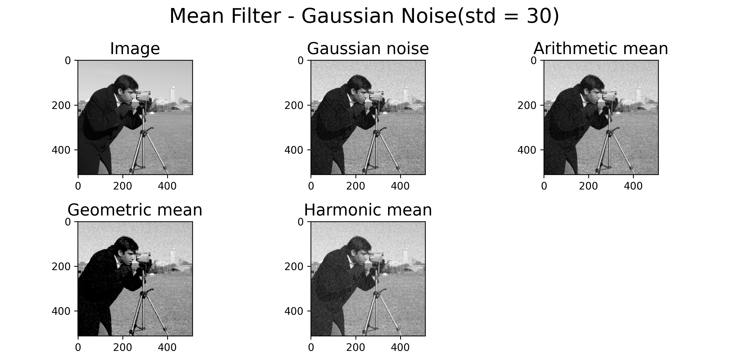
Mean Filters

Slide 16
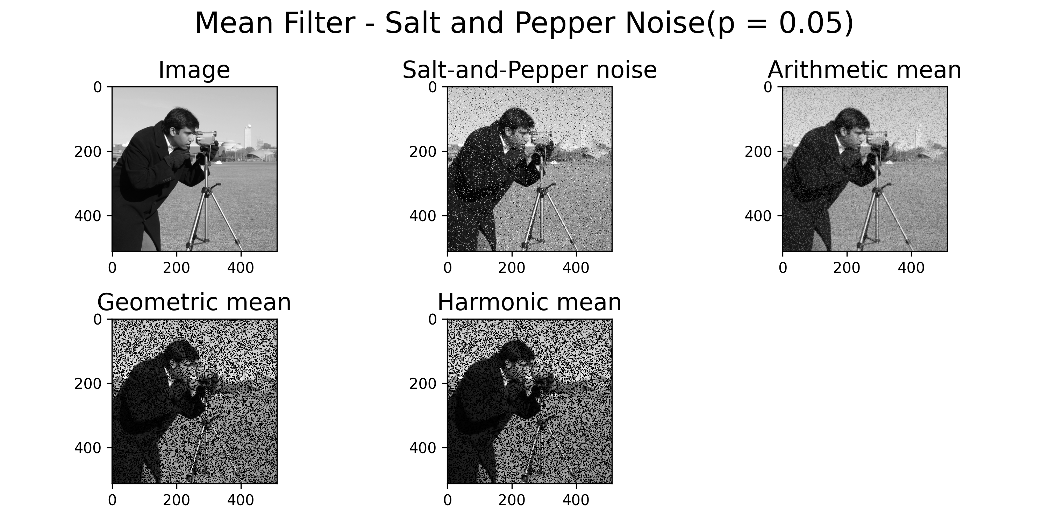
Mean Filters

Slide 17
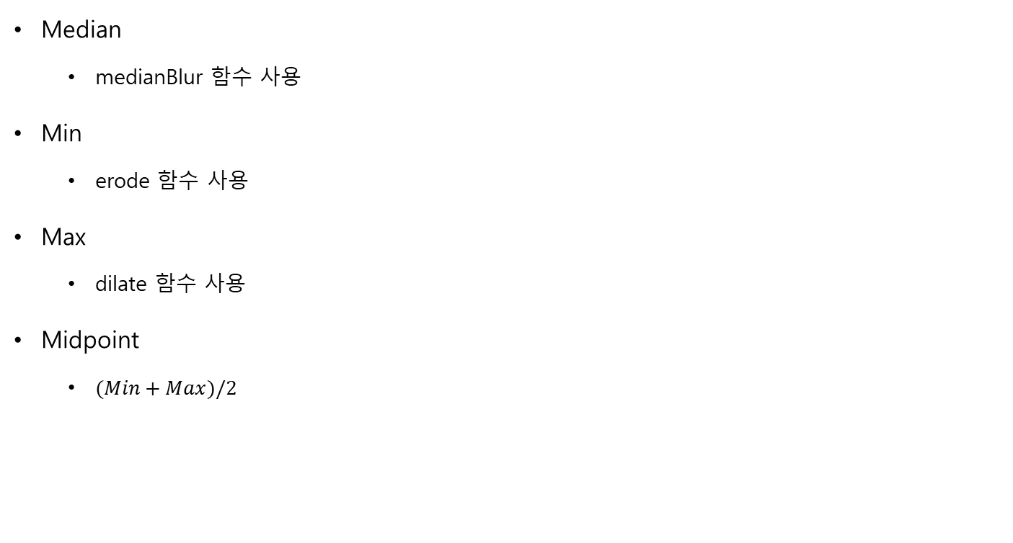
Order Statistics Filters
Median
medianBlur 함수 사용
Min
erode 함수 사용
Max
dilate 함수 사용
Midpoint
$(Min+Max)/2$
std = 30 p = 0.05 src_img = data.camera() gas_img = noise_gaussian(std, src_img) sap_img = noise_sap(p, src_img) med_img = cv2.medianBlur(gas_img, 3) med_img2 = cv2.medianBlur(sap_img, 3) size = (3, 3) shape = cv2.MORPH_RECT kernel = cv2.getStructuringElement(shape, size) min_img = cv2.erode(gas_img, kernel) min_img2 = cv2.erode(sap_img, kernel) max_img = cv2.dilate(gas_img, kernel) max_img2 = cv2.dilate(sap_img, kernel) mid_img = 0.5 * (min_img + max_img) mid_img2 = 0.5 * (min_img2 + max_img2)

Slide 18
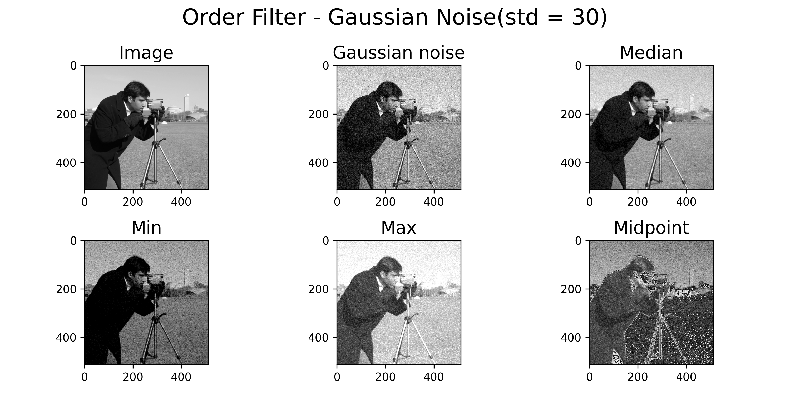
Order Statistics Filters

Slide 19
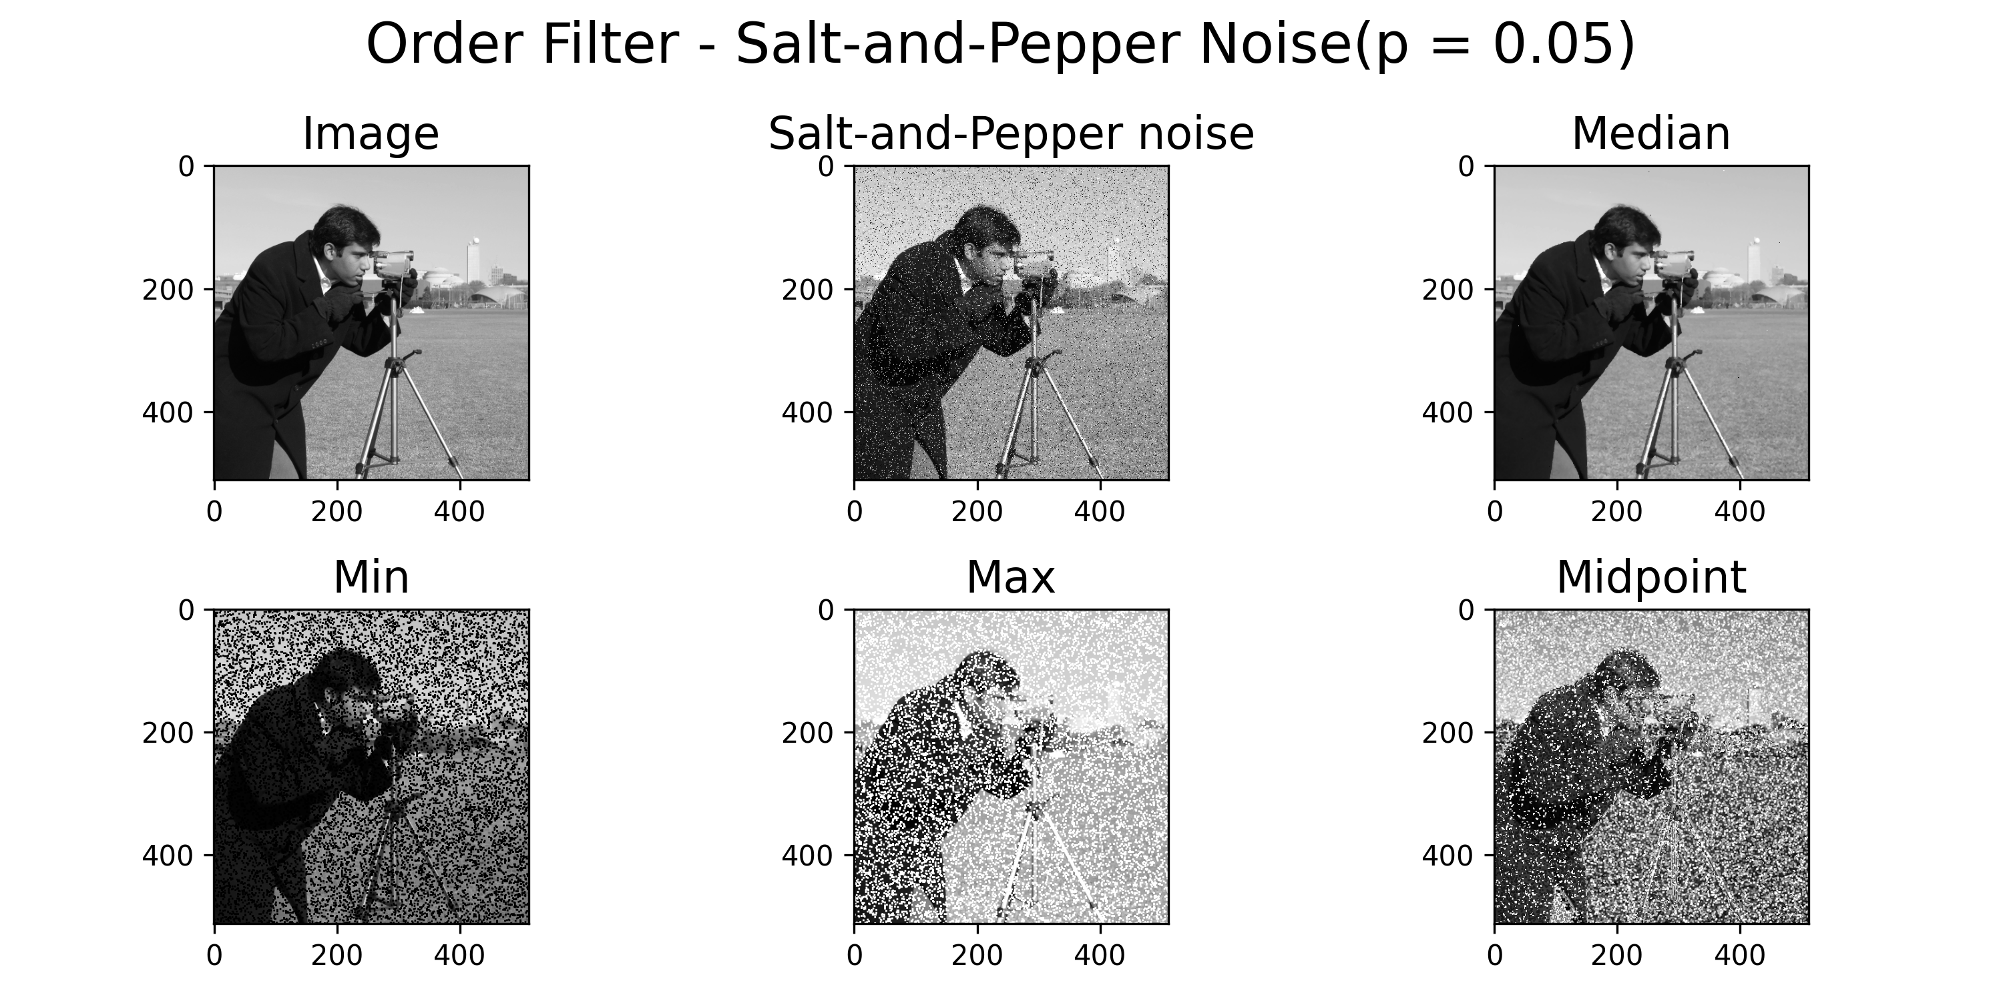
Order Statistics Filters

Slide 20
3.

